Slide 1
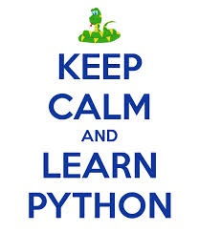
06. Python – Miscellaneous Topics - I

Slide 2
Topics
1
Comprehension
2
Global and Local Variables
3
File Operations
4
Exception Handling
5
Modules
6
Packages
I
Problems
II
Assignments

Slide 3
Comprehension
List Comprehension
*result* = [*transform* *iteration* *filter* ]
Examples:
S = [x**2 for x in range(10)] V = [2**i for i in range(13)] M = [x for x in S if x % 2 == 0]
Dictionary Comprehension
Examples:
C = {x: x**2 for x in [1,2,3,4,5]}
D = {x.upper(): x*3 for x in 'abcd'}

Slide 4
Local and Global Variables
Local variables can be accessed only inside the function in which they are declared
Global variables can be accessed throughout the program body by all functions
Examples:
testVar = 0
def testFunc():
global testVar
testVar += 1
print testVar
testFunc()
print testVar

Slide 5
Local and Global Variables
testVar = []
def testFunc1():
testVar = [2] # Will create a local testVar and assign it [2], but will not change the global variable.
def testFunc2():
global testVar
testVar = [2] # Will change the global variable.
def testFunc3():
testVar.append(2) # Will change the global variable.

Slide 6
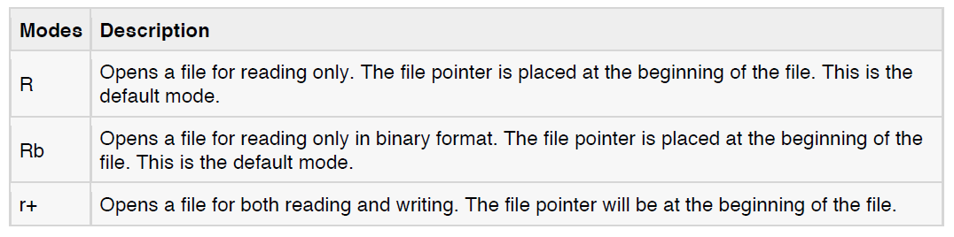
File Operations
Reading Keyboard Input:
• raw_input
• input
Opening and Closing Files:
The open Function:
file object = open(file_name , access_mode, buffering)
access_mode:

Slide 7
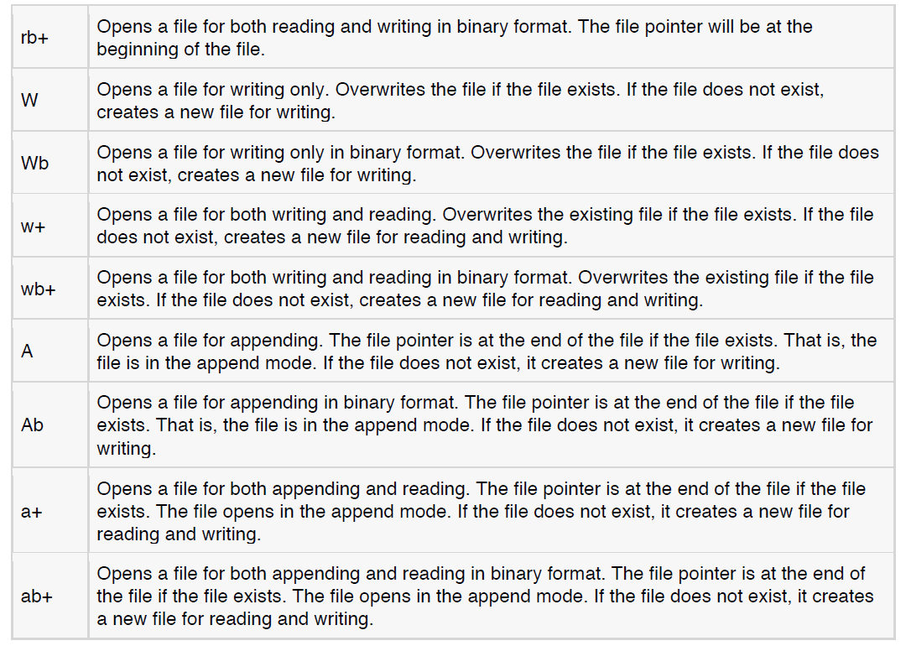
File Operations

Slide 8
File Operations
The close() Method:
fileObject.close()
Reading and Writing Files:
The write() Method:
fileObject.write(string)
The read() Method:
fileObject.read([count]

Slide 9
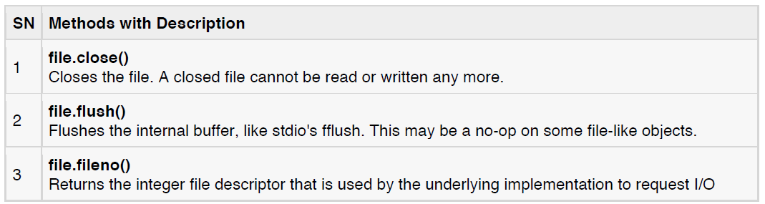
File Operations
File Object Methods

Slide 10
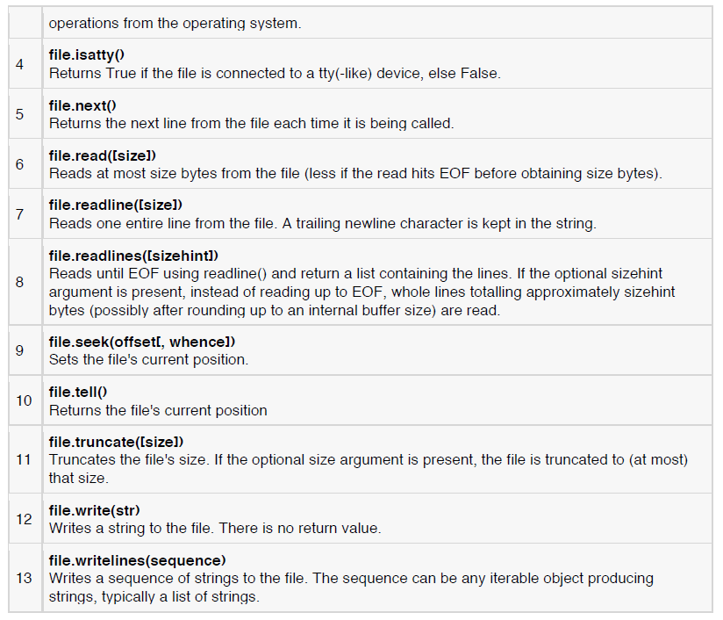
File Operations

Slide 11
Exception Handling
Assertions:
An assertion is a sanity-check that you can turn on or turn off when you are done with your testing of the program.
>> assert condition
it's roughly equivalent to this:
>> if not condition:
raise AssertionError()
Exceptions:
An exception is an event, which occurs during the execution of a program, that disrupts the normal flow of the
program's instructions.

Slide 12
Exception Handling
try:
You do your operations here;
......................
except ExceptionI:
If there is ExceptionI, then execute this block.
------------------
except ExceptionII:
If there is ExceptionII, then execute this block.
......................
else:
If there is no exception then execute this block.

Slide 13
Exception Handling
try:
You do your operations here;
......................
Due to any exception, this may be skipped.
finally:
This would always be executed.
......................
Raising an exceptions:
def functionName( level ):
if level < 1:
raise "Invalid level!", level
# The code below to this would not be executed
# if we raise the exception

Slide 14
Exception Handling
try:
Business Logic here...
except "Invalid level!":
Exception handling here...
else:
Rest of the code here...
User Defined Exceptions

Slide 15
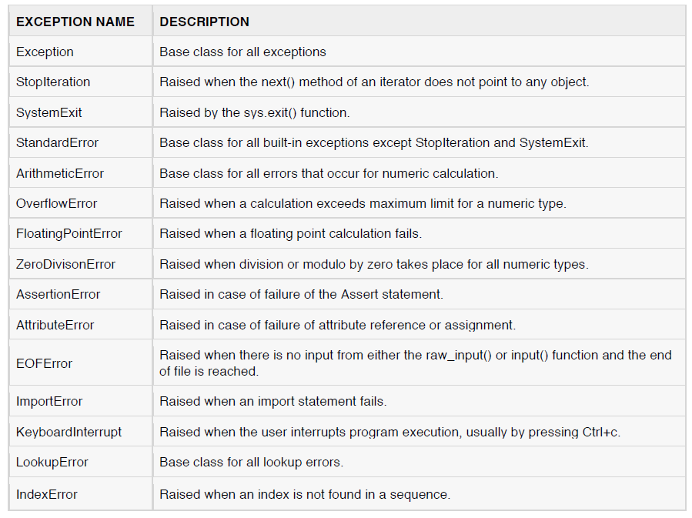
Exception Handling

Slide 16
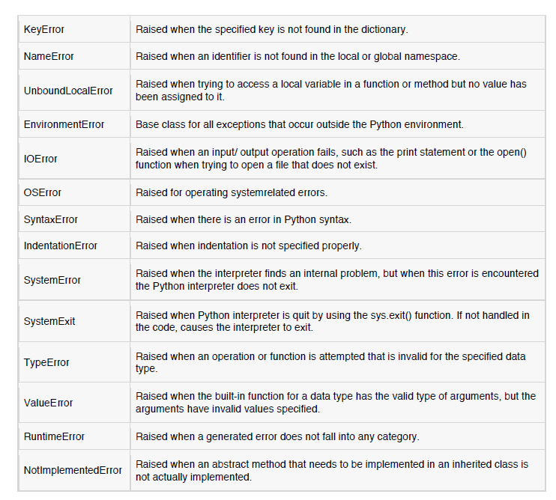
Exception Handling

Slide 17
Modules
• A module is a file consisting of Python code.
• A module can define functions, classes and variables.
A module can also include runnable code.
• The import Statement:
import module1, module2,... moduleN
• The from...import Statement
from modname import name1, name2, ... nameN
For example, to import the function fibonacci from the module fib, use the following statement:
from fib import fibonacci

Slide 18
Modules
The from...import* Statement:
from modname import *
Locating Modules:
The current directory.
If the module isn't found, Python then searches each directory in the shell variable PYTHONPATH.
If all else fails, Python checks the default path. On UNIX, this default path is normally /usr/local/lib/python/.
The dir() Function:
The dir() built-in function returns a sorted list of strings containing the names defined by a module.
The list contains the names of all the modules, variables and functions that are defined in a module.

Slide 19
Modules
Example:
import math
content = dir(math)
print content;

Slide 20
Packages
A package is a hierarchical file directory structure that defines a single Python application environment that
consists of modules and subpackages and sub-subpackages, and so on.
Examples:
Package Name: Phone
__init__.py
Pots.py
Isdn.py
G3.py
__init__.py File:
from Pots import Pots
from Isdn import Isdn
from G3 import G3

Slide 21
Packages
# Now import your Phone Package.
import Phone
Phone.Pots()
Phone.Isdn()
Phone.G3()

Slide 22
Assignments
Write a program to
a) list1 = list all the integer numbers between 1 and 100 using list comprehension.
b) list2 = list containing the squares of the integer numbers in list1 using map and lambda.
c) list3 = list of all even numbers in list2 using filter.
2) Write a program to copy the contents from “input.txt” to “output.txt” using file “read” and “write” operations.
3) Write a program to solve the following sudoku.
(Note that the table is in an excel file.)
1
 |  | 1 | 3
4 | 2
 |  |  | 2

Slide 23
Thank you
for your attention!

